Slide 1
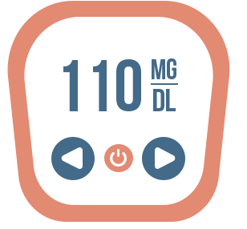
NLP Analysis of CGM for Diabetes
Are customers satisfied with current available CGMs?
Xi Yan (xiyan)
Wanying Zhang (wanyingz)
Tiffany Huang (thhuang)

Slide 2
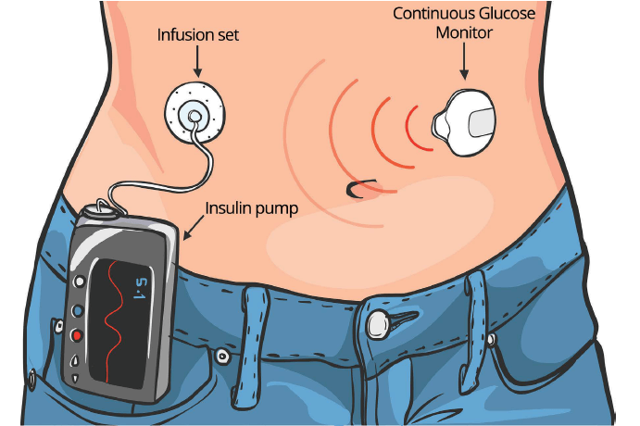
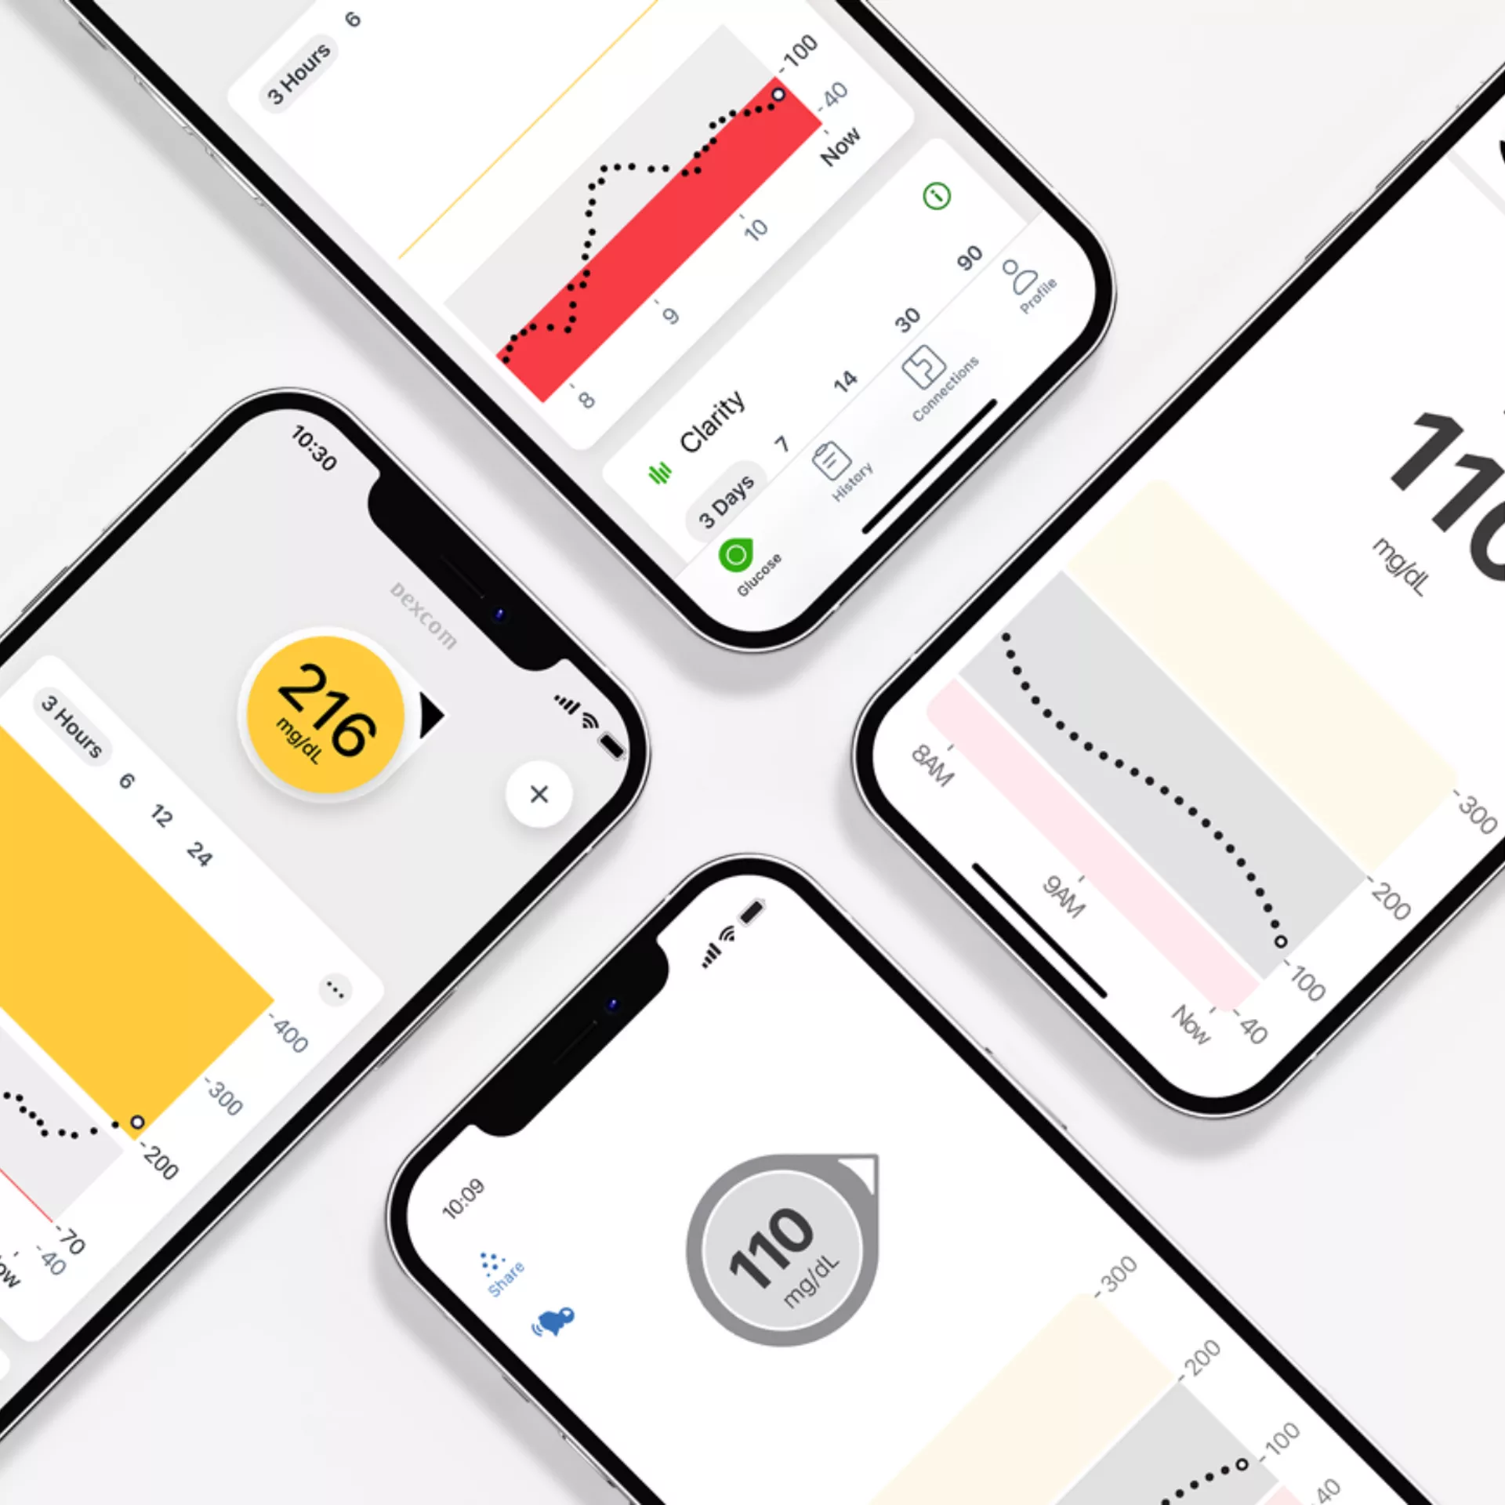
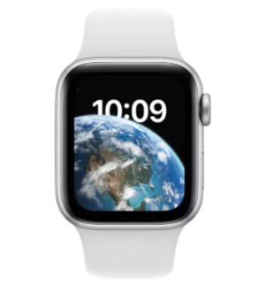
Executive Summary
Three products are important for diabetes patient to manage their disease status:
Continuous Glucose Monitor, Insulin Pump (Closed Loop System), Data-Recording/Reading APP
Key factors to meet patient satisfaction
1
1
UI friendly
CGM - Accuracy
1
3
user expectation
Apple Watch
1
1
2
1
Insulin Pump - Streamline with
CGM
Notes:
Source: https://www.umassmed.edu/dcoe/diabetes-education/pumps_and_cgm/

Slide 3
TABLE OF CONTENTS
01.
Background & Problem Statement
02.
Project Workflow & EDA
03.
Result - General Analysis - Product Analysis
04.
Summary & Recommendation

Slide 4
01.
Background

Slide 5
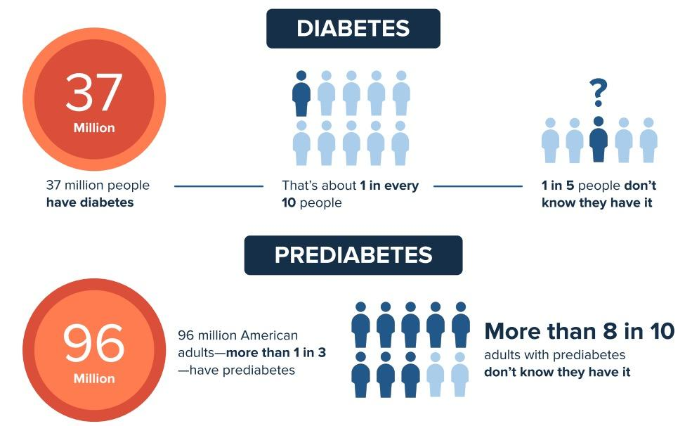
Notes:
Last Reviewed: August 11, 2022
Source: Centers for Disease Control and Prevention
According to CDC’s report in 2022, in US, 37 million people have diabetes and that’s about 1 in every 10 people. And on top of that, 96 million people have prediabetes, that’s about 1 in every 3 people. So diabetes affects lots of people and it actually the 7th leading cause of death in U.S.

Slide 6
Why CGMs?

Slide 7
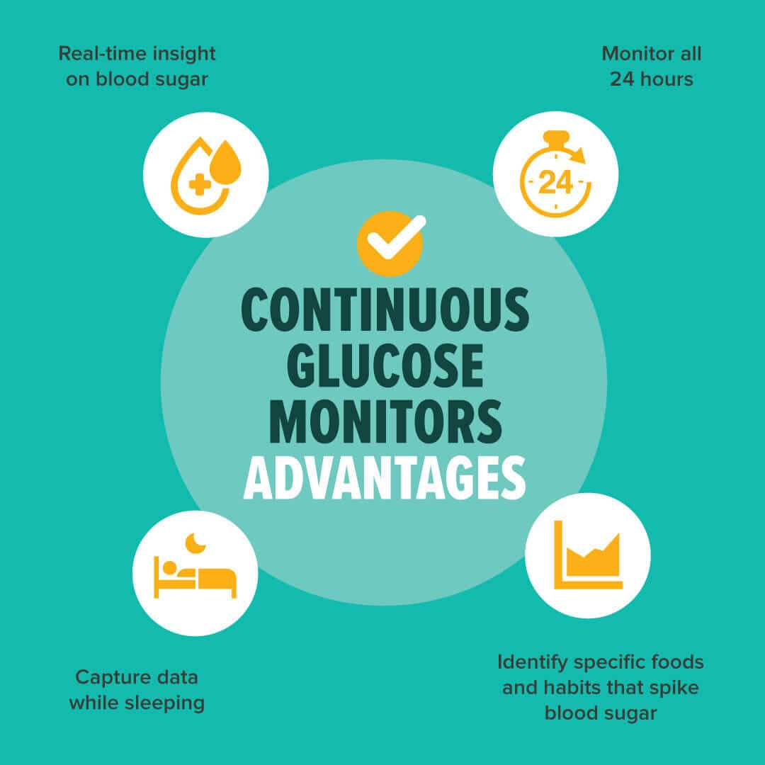
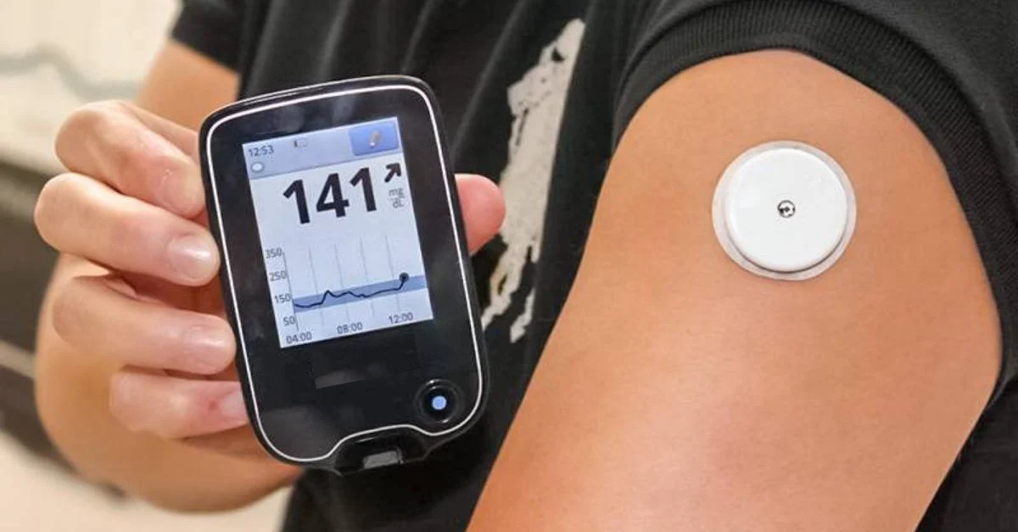
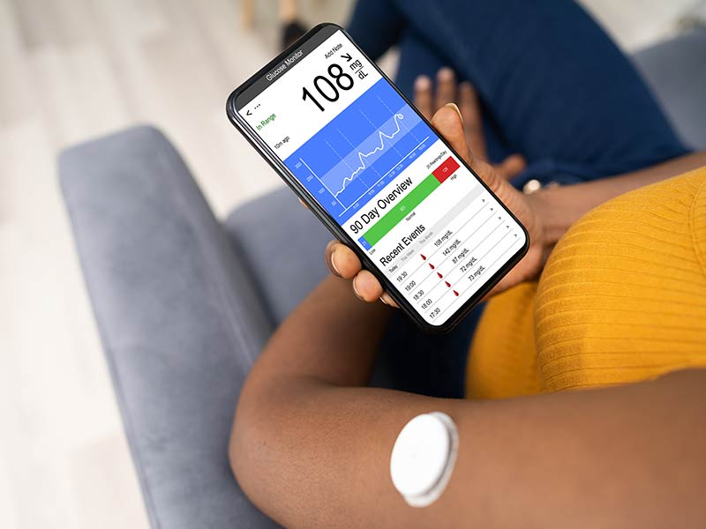
Receiver/reader
App
Notes:
Just like the Continuous term in the name, it can show users the real-time changes of their blood glucose levels 24/7 if their batteries allow. Therefore, it’s easy for them to identify what kind of food or habits causing their blood sugar spike.

Slide 8
02.
Project Workflow
& Data

Slide 9
Project Workflow
Phase 2
Phase 4
NLP text data
General CGM analysis
Data Preprocessing
Text Processing
Exploratory DA
General Analysis
Product Analysis
Phase 1
Phase 3
Phase 5
Drop columns
Visualize dataset
Categorized CGM product analysis

Slide 10
Raw Data
63 Columns
37,844 Rows
4/1/2021 - 9/2/2022
42 Columns containing > 90% missing value
Imbalanced Source Type
Social media posts contain emojis, hashtags and links
Forums occupies 92% data

Slide 11

Pre-processing
Analysis Methods
Handle missing data / columns
Remove links/punctuations
emojis
Words Frequence
Analysis
Business Insight
Text Processing
Tokenize text
Topic Modeling
Remove stopwords
Lemmatization

Slide 12
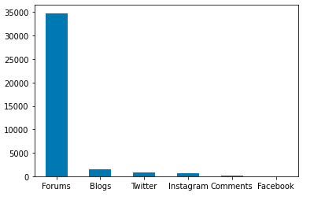
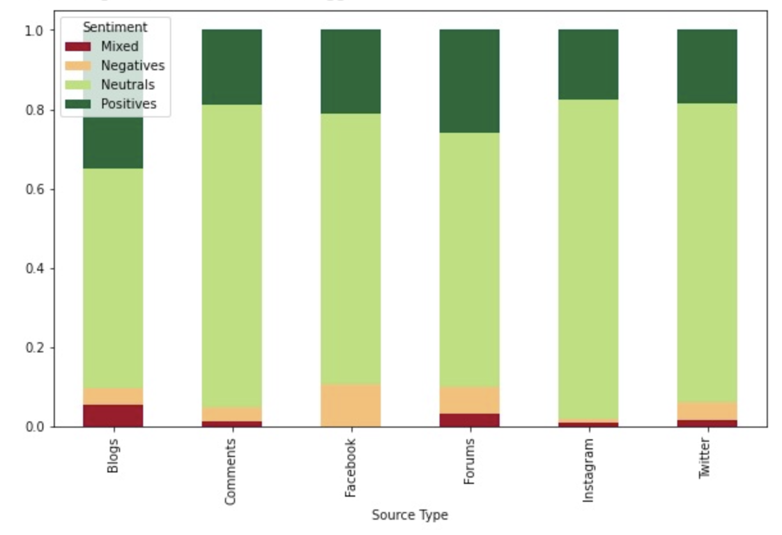
Exploratory Data Analysis
Imbalanced number of posts across sources
Distribution of sentiments across data sources

Slide 13
03.
Results
- General Analysis - Product Analysis

Slide 14
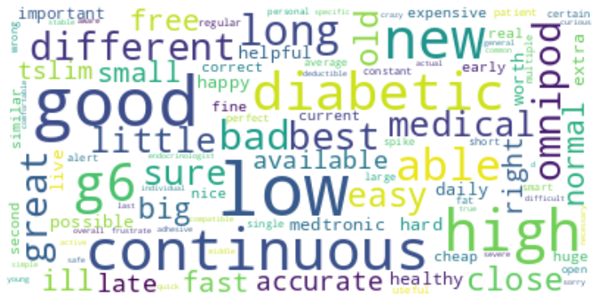
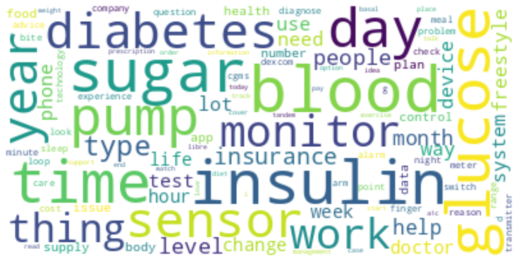
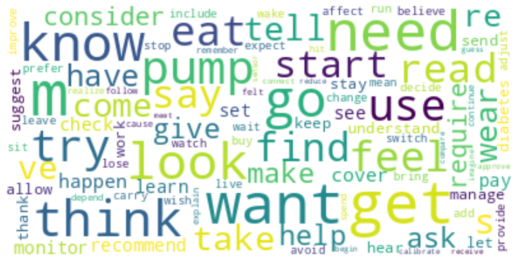
General Product Analysis… Initially
Single word does not provide insights
Of course we know “blood”, “good”, “want” we be on the cloud!

Slide 15
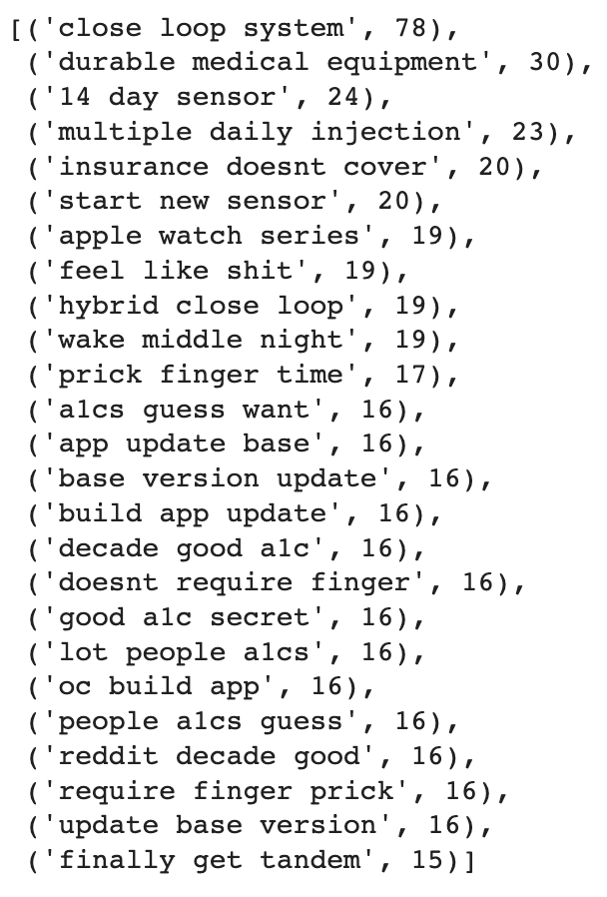
General Product Analysis… Then
cgm_stopword = [‘good’, ‘blood’, ‘glucose’.......]
CountVectorizer(stop_words=cgm_stopword, ngram_range = (3, 3))

Slide 16
General Product Analysis Result
EXPECTATION
['expect', 'want', 'need','look', 'forward', 'require', 'anticipate', 'desire', 'prefer', 'hope', 'wish', 'envision', 'imagine', 'plan', 'consider', 'suggest'...]
Close Loop System
Durable Medical Equipment
Apple Watch Series
Evaluation:
Close Loop System : Want to know more about the Closed Loop System
Durable Medical Equipment: Want to know which suppliers covers CGM as DME so patients’ insurance will cover it
Apple Watch Series: Hoping for future roll out of CGM app compatibility / blood sugar monitor on next generation Apple Watch

Slide 17
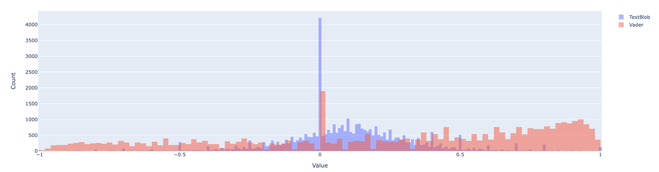
General Product Analysis Result
UNMET NEEDS
BENEFIT
Vader 10% Threshold
Textblob 10% Threshold
Base Version Update
Low Blood Sugar
High Blood Sugar
Continuous Glucose Monitor
Does’t Require Finger
Textblob 10% Threshold
Vader 10% Threshold
Evaluation:
Unmet Needs:
Version Update Slow, People develop software themselves
Blood Sugar monitor inaccurate, false low or false high
Benefit:
CGM itself
No finger pricking

Slide 18
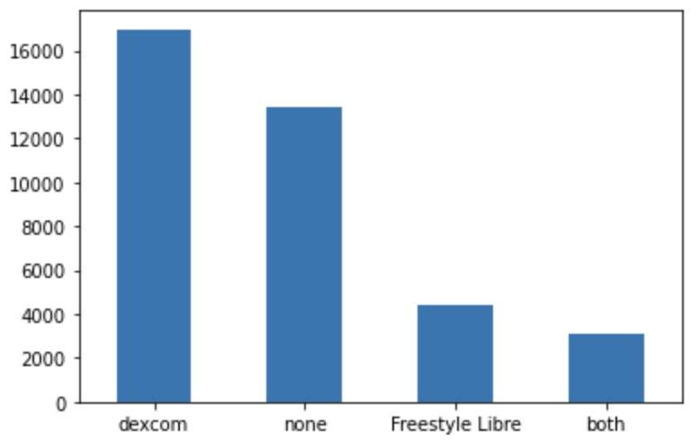
Product Analysis
Dexcom has about 4 times more posts than Freestyle Libre
Notes:
For product analysis, we

Slide 19


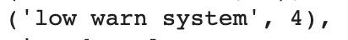
Product Analysis - Dexcom
Features
Word Frequency Analysis
Closed loop system (Compatible with Tandem tslim x2 insulin pump)
Blood sugar warning system
Dexcom App
Verification
If you get a good closed loop system, adding a sensor to your pump can make managing blood sugars a lot less work imo. When I switched to a tslim + Dexcom with control IQ, I noticed I was doing a lot less manual correction boluses because the system did it for me (more or less), and I was spending less time waiting for my blood sugar to come down because I'm in range more of the time. So in that sense having another device could actually be easier.

Slide 20
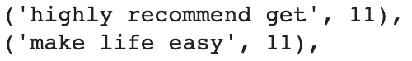
Product Analysis - Dexcom
Praises
Word Frequency Analysis
Allow users to manage their health better and easier
Set users free from abusing fingers
Easy to use and adjust products
Verification
Diagnosed 2018 in my twenties. I use a tandem pump and dexcom G6. I can’t express how much it has changed my life for the better. SIGNIFICANTLY helped to lower my A1c and just made my overall life easier.

Slide 21
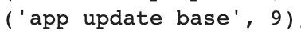
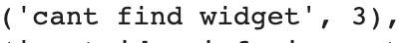
Product Analysis - Dexcom
Complaints
Word Frequency Analysis
App not user friendly
Cost
Unstable Bluetooth
Compatible issue with Android
Inaccurate reading (false low)
Verification
I’ll make this quick as I can- we have a iPhone 12 mini that we use for my sons Dexcom G6. We loose Bluetooth connection ALL THE TIME. We have to constantly toggle the Bluetooth off and on to get it to reconnect. 5-10 times per day. So sick of it. So for my question and TLDR: What phone do you use with your Dexcom G6 and how reliable is the Bluetooth connection? Thanks in advance!

Slide 22
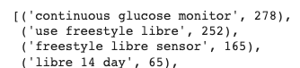
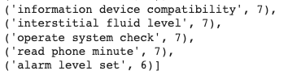
Product Analysis - Freestyle Libre
Features
Word Frequency Analysis
Continuous glucose monitor
Wearable device
Flash Monitor System
Freestyle Libre APP
Glucose Level Alert
Compatible with insulin pump (Medtronic)
Verification
New sensor day!! I never thought when I was diagnosed 18 years ago that a cgm (continuous glucose monitor) would be a possibility, now I couldn’t imagine my day to day life without it☀️and now libre2 sends alerts when going hypo/hyper!!

Slide 23
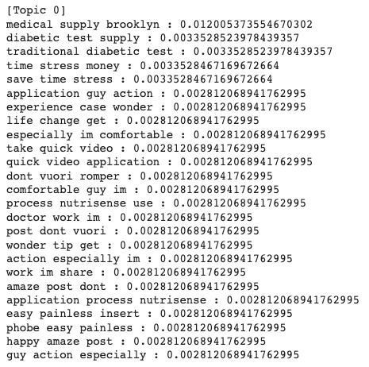
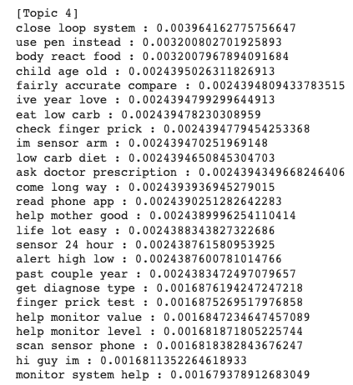
Product Analysis - Freestyle Libre
Praises
Topic Modeling
Fairly accurate
Painless when insert the sensor
compatible with app, easy for data reading
Good for health management (chronic disease monitoring)
Affordable price!
Verification
… I've had a Freestyle Libre 2 CGM for a couple of months now and it's been fantastic. Insertion is painless and easy, checking is as simple as tapping it with the reader, …
Notes:
@Type2Princess The Freestyle libre is handy and not super expensive. About 120 Euro a month without any subsidies. I love it and wouldn't go back.

Slide 24
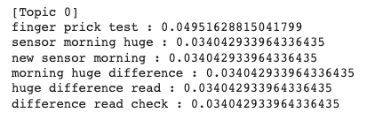
Product Analysis - Freestyle Libre
Complaint
Topic Modeling
Fairly accurate
Painless when insert the sensor
compatible with app, easy for data reading
Good for health management (chronic disease monitoring)
Affordable price!
Comfortable
Inaccurate - new sensor replacement
App unresponsive
Non-recyclable material
Medtronic 770G - backward technology
Verification
Freestyle Libre 2 - new sensor this morning HUGE difference between reading and blood check
wow and I thought the freestyle libre has a lot of waste So much trash for just one infusion and cgm change. Anyone else feel bad about the amount of non recyclable trash that comes with trying to stay alive?

Slide 25
Are people satisfied with current available CGMs?

Slide 26
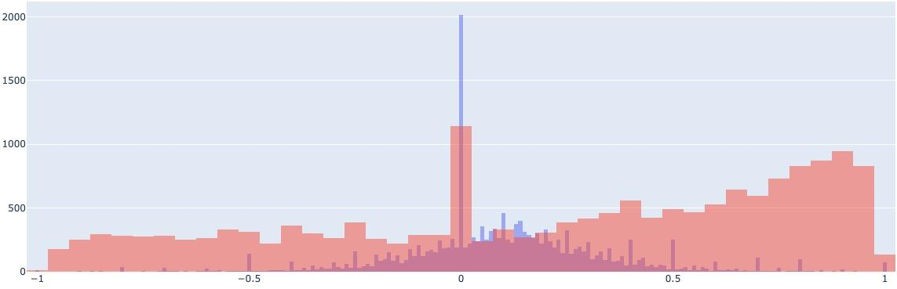

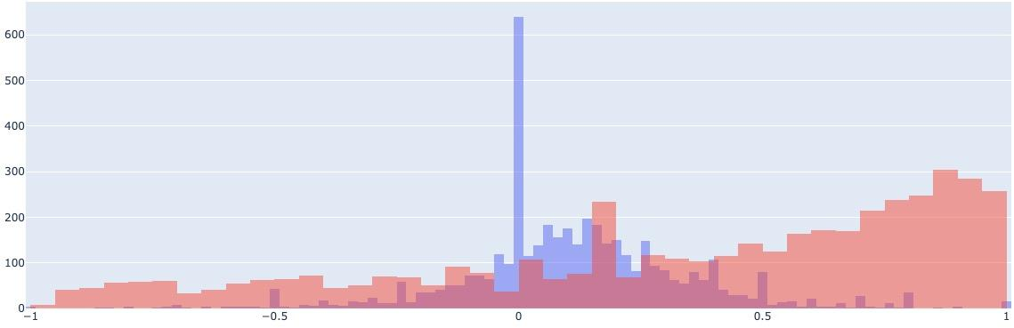
Overall Sentiment Regarding Two Products
Dexcom
Freestyle

Slide 27
Comparison between Dexcom & Freestyle Libre
 | Features | Complaint
Dexcom & Freestyle Libre | Continues Glucose System Close loop system (Compatible with insulin pump) Blood sugar warning system Compatible with App | App issue - unresponsive - unfriendly UI Inaccurate reading
Dexcom |  | Compatible issue with Galaxy Note cost
Freestyle Libre |  | Sensor issue Non-recyclable material Medtronic 770G - backward technology
Notes:
Note: Data is imbalance

Slide 28
Recommendations for CGM companies
CGM Accuracy is important for diabetes patient to monitor their glucose value
APP design & operation smoothness affect users’ product satisfaction level
Users expect to have closed loop system cooperate with CGM system. CGM companies should carefully pick their business partner or consider to expand the business into insulin pump market.
Challenge or Opportunity? Users expect to see the CGM function on Apple watch. CGM companies should focus on their APP design more or consider the opportunity to cooperate with Apple.
For Dexcom
For Freestyle Libre
App User Instructions need to be revised
Improve Bluetooth connectivity
Increase compatibility with Android phones
Sensor issue to be resolved
Replace the consumable items with the recyclable material
Cooperate with other insulin pump company
Collect more data to do the analysis

Slide 29
FAQ

